Slide 1
Using Qualtrics Data Data Skills for Research Kellogg Research Support
July 11, 2024
Notes:
Welcome. We are so happy you’re here.
What you are about to hear next is about the closest you will get to a lecture in this workshop series. Most of the rest of this will be pretty interactive.
There will be discussions and you follow along with a demonstration, and maybe try to solve a few problems yourself.
But before we get into demonstrations of tools and how to apply them to your research work, I want to talk a bit about the reproducibility of that work you are about to start.
It is a very important topic, and I believe there are a few general principles that, if kept in mind, can help you quite a lot when you go to reproduce your work in the future.

Slide 2
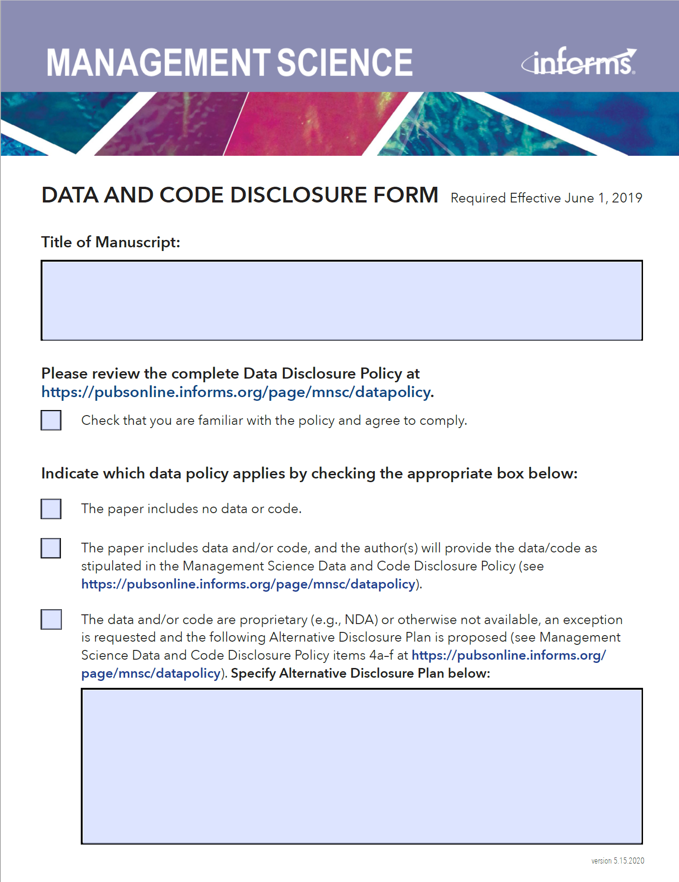
Changing Requirements for Publishing
Notes:
GINGER
Journals are starting to implement OS requirements, we are in a time when the requirements are always changing and moving twd more OS
Expect skepticism in reaction to your work, think about how to anticipate this; ppl will try to recalculate what you did, try different inclusion data (investigate how different subsets of data affect the results. For example, they could analyze a dataset with different subsets of participants or exclude certain outliers to understand the impact on the findings)
--> you may have submitted last year, and now they have a new policy you must adhere to

Slide 3
Replication Principles
Automate wherever possible
Keep good records
Break workflows into modular chunks
Test

Slide 4

Qualtrics Data Workflow
Never overwrite!
Extract | Collect Raw Data
Prep Data
for Analysis
Analyze
Data
Logging and testing via programs (version controlled)
Source data files can change!
Notes:
This should be obvious to everyone. You should always document your code, and more comments and read-me files is bound to make things easier for your future self. Right?
<pause for effect>
<CLICK>
Actually, NO! I maintain that less is more when it comes to documentation.
In any event, you ABSOLUTELY MUST maintain your documentation. So if you have got comments running throughout your code, that’s fine,
but you will need to update the comments each time you update the code. Otherwise, you run the risk of your code doing one thing and your comments saying another.
That is a sure fire recipe for confusion when you crack open your Python program for the first time in 24 months to figure out why the numbers are suddenly different.

Slide 5
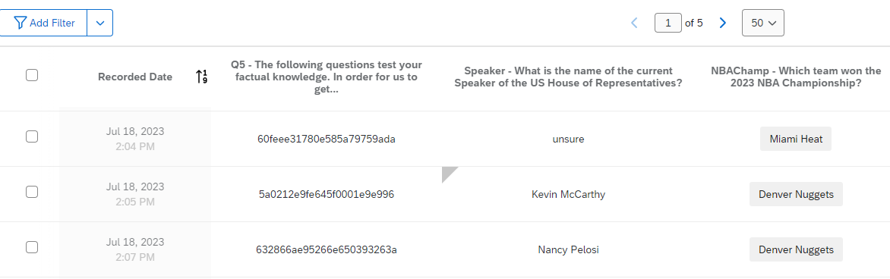


Beware: Response Editing Feature!
Notes:
Fortunately for you, this is a management, and we have some commonsense ideas for how to make collaborations – including with your future self – work better.
Some of those concepts that are most relevant to your scientific computing projects include:
Keeping records of what you do that will be easy to use,
Being very economical with your solutions. The #1 easiest way to fail at replicating your results is to present yourself with 2 different ways to solve the same problem.
And recognize that humans make mistakes. We forget things. We sometimes make poor decisions. So more generally, give your future self fewer opportunities to make mistakes.

Slide 6
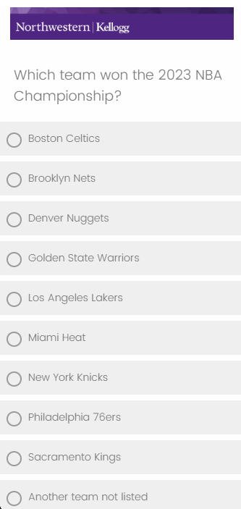
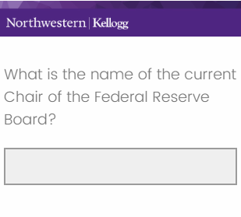
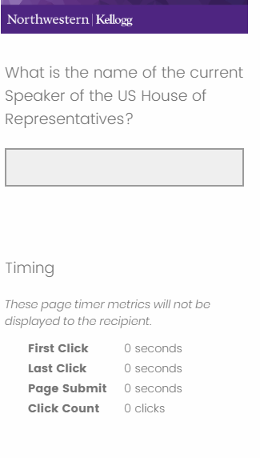
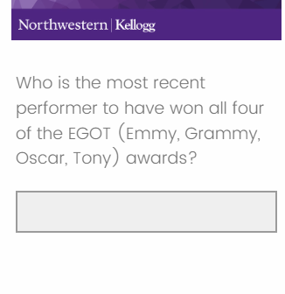
Survey Questions for Demo
Notes:
These are some of the questions that we asked in the survey that we will use in the demo. They essentially test knowledge of some current events or trivia-type questions. We figured while many people will immediately know the answers to some questions, most people would not be able to answer all of them without help.
Note: we measured response time for all these questions. Respondents were asked not to look up answers using outside sources, and the response times would give us some suggestion of whether they did this or not.

Slide 7
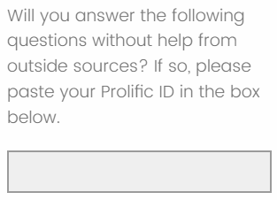
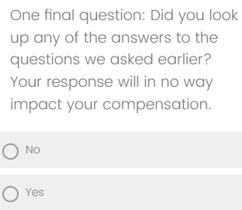
Survey Questions – No Outside Help
Notes:
In addition, we asked a few other questions to help us understand

Slide 8
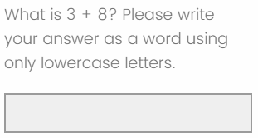
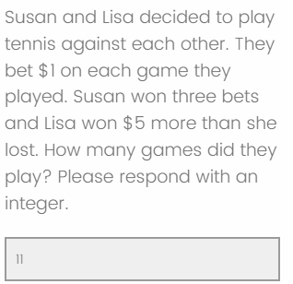
Attention and Comprehension Checks
Notes:
In addition, we asked a few other questions to help us understand

Slide 9
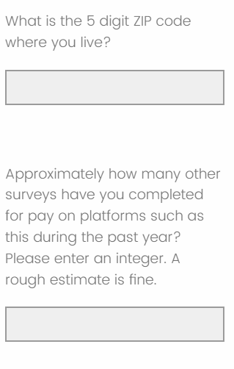
Respondent Attributes
Notes:
In addition, we asked a few other questions to help us understand

Slide 10
To Use The Demonstration Program (R)
KLC details:
https://www.kellogg.northwestern.edu/research-support/computing/kellogg-linux-cluster
You will need a Qualtrics account, prior survey activity.
Change program to search for your survey title.
Run a one-time step to add your Qualtrics credentials to .Renviron.
Found under Account Settings / Qualtrics IDs: API Token, Organization ID, Datacenter ID

Slide 11
Demonstration
Notes:
Discussion to get started
What platforms do you use for deployment?
What software do you use for statistical analysis? For data cleaning?
What platforms do you use to gather online survey data?
Tell me some things you normally have to do to your raw survey data before it is ready to analyze.

